Slide 1
Animation Supported Consent for Coronary Artery Bypass and Aortic Valve Replacement Procedures
Abstract presented at Society of Cardiothoracic Surgeons, Belfast 2021

Slide 2
declaration
David Wald is Founder and Director of Explain my Procedure Ltd that created the animations used in this QI project and Audit

Slide 3
Methods and Sample
Baseline understanding of Coronary Artery bypass and Aortic valve replacement procedures (Questionnaire) n=21
Videos animations developed by Explain my Procedure Ltd ©
Links to videos sent out to patients preadmission
(patients watching videos preadmission n=4)
Patients watching videos preoperatively on Videobook (n=12)
Understanding of Coronary Artery bypass and Aortic valve replacement procedures (Questionnaire) n=16
Videobook

Slide 4
Results – understanding of the procedure

Slide 5
Results – understanding of the procedure’s Benefits

Slide 6
Results – understanding of the procedure’s Risks

Slide 7
Results – understanding of the procedure’s Alternatives

Slide 8
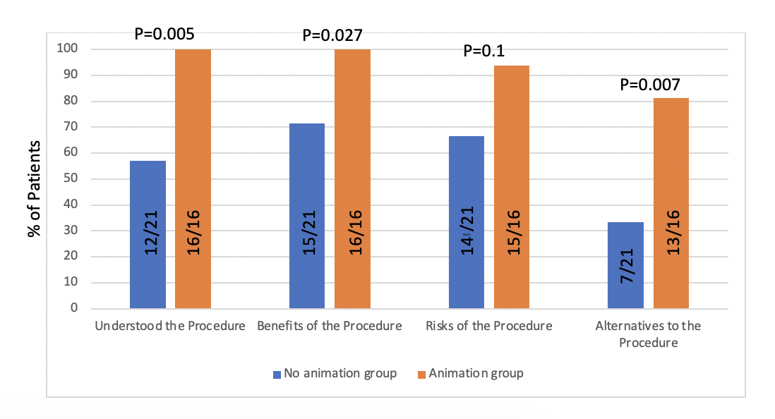
Results – Summary of patient understanding

Slide 9
Results – Feedback from patients
Poor eyesight cant read but able to watch videos. Video book is fantastic and comprehensive. Video book is fantastic would recommend Excellent video, would recommend Translation really good and simple, useful video Very useful video as cant read or write Would recommend video Watched with family. Very useful would recommend Very comprehensive, time saving. Would recommend as first line communication to patients Would recommend video Brilliant video would recommend | Video of procedures make me anxious. As afraid of blood etc. Video link didn’t work as poor quality QR code printed on recycled paper.

Slide 10
Conclusion
Baseline patient understanding of procedure, benefits, risks and alternatives was moderate to poor indicating a need for quality improvement.
Animation support led to a greater level of understanding across all consent domains : procedure, benefits, risks and alternatives.
Patients who watched the animations would recommend their use to others

Slide 11
ACKNOWLEDGEMents
Thanks to Explain my Procedure Ltd for creating the animations and making them available for use during the audit. © ExplainmyProcedure.
Professor David Wald (Consent Lead) for overall supervision of audit
Alex Shipolini (Cardiac Suregeon) for implementation support
David Ike and Matthieu Durrand-Hill (surgical trainees) for audit data collection

